Slide 1
Testing with JUnit and Mockito

Slide 2
Outline
JUnit
JUnit Annotations
Junit Assertion Methods
Stubs & Mocks
Mockito

Slide 3

JUnit

Slide 4
JUnit
JUnit is an open-source java framework designed for the purpose of writing and running unit testing.
JUnit 5 is the most widely used testing framework for java applications.
JUnit allows for the creation of both application code and test during development.
JUnit also provides a graphical user interface (GUI) which makes it possible to write and test source code quickly and easily.
JUnit shows test progress in a bar that starts green if testing is going fine, but turns red when a test fails.

Slide 5
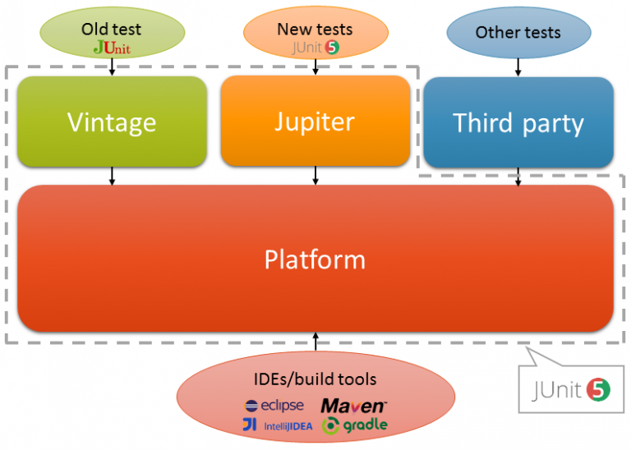
Junit 5 Ecosystem
Junit 5 is composed of several different modules from three different sub-projects:
JUnit 5 = JUnit platform + Junit Jupiter + Junit Vintage

Slide 6
JUnit Platform
Used to be able to launch JUnit tests, IDEs, build tools or plugins need to include and extend platform APIs
Defines the TestEngine API for developing new testing frameworks that run on the platform
Also provides Console Launcher to launch the platform from the command line and build plugins for Gradle and Maven.

Slide 7
JUnit Jupiter
Includes new programming and extension models for writing tests
Has all new JUnit annotations and TestEngine implementation to run tests written with these annotations

Slide 8
JUnit Vintage
Supports running tests written for JUnit 3 and JUnit 4 on the JUnit 5 platform.
i.e. ensures backward compatibility.

Slide 9
JUnit Annotations

Slide 10
JUnit 5 Annotations | Basics
JUnit uses several annotations within the org.junit package that developers can use to create tests and setup test environments:
@Test – declares a method as a test method
@BeforeAll – declares a setup method that runs once, before all other methods in the class. This method must be static.
@BeforeEach – declares a setup method that runs before each test method is run
@AfterEach – declares a ‘tear-down’ method that runs after each test method
@AfterAll – declares a ‘tear-down’ method that runs once, after all other methods in the class. This method must be static.
@Display – Controls the display name of the test in the test runner output
@Disable – declares that the proceeding test class or method will not be run.
Note: When disabling tests, a string argument can be passed which gives information regarding the skipped test. A valid, and descriptive reason should always be provided when skipping tests.

Slide 11
JUnit 5 Annotations | Features
Aside from the basic Annotations, Junit provides additional annotations which provide more convenience and flexibility when writing test files.
These annotations help reduce redundancy (duplication of test logic) and organize the structure of your test files:
@Nested – Declares a class as nested – used to organize test logic
@ParameterizedTest – Used to declare that values will be supplied to a test from a source. Sources should be included as a separate annotation:
@ValueSource – Used to provide a simple value to a Parameterized test
@CsvSource – Used to provide a comma-separated list of arguments to a parameterized test
A list of all ‘Source’ annotations can be found in the documentation: org.junit.jupiter.params.provider (JUnit 5.5.0-M1 API)

Slide 12
JUnit Assertion Methods

Slide 13
JUnit Assertions
Assertions help validate the expected output with actual output of a test case.
All JUnit Jupiter assertions are static methods in the ‘org.junit.jupiter.Assertions’ class.
E.g. ‘org.junit.jupuer.Assertions.assertEquals()’
The syntax for most assertions methods is a variation of the following:
assertMethodName( expected_value, actual_value, String message)

Slide 14
Static Imports
When importing functionality from a library. You can import static methods and/or variables using a ‘static import’.
A static import uses the keyword static
Static imports are convenience imports that allow you to reference a static method/variable as if it were declared in your importing class, rather than appending the class name:
i.e. myStaticMethod() vs MyClass.myStaticMethod()
It is common practice to use static imports on static methods that are called frequently in your code, to increase legibility and reduce bloat.

Slide 15
JUnit Assertions - Methods
assertEquals() / assertNotEquals() – Test to see if an actual result matches or differs from an expected, respectively
assertThrows() – Test to see if an expected object is thrown from the method under test
assertNull() / assertNotNull() – Test to see if a reference is null or not, respectively
assertArrayEquals() – Test to see if the values of an array match a provided array.
assertTrue() / assertFalse() – Test to see if a result is true or false, respectively
assertAll() – Tests a series of assertions, but reports the passes and fails separately – so all grouped assertions will be executed
Note: Adding multiple assertions to a test normally would halt the test as a failure.

Slide 16
Stubs and Mocks

Slide 17
Test Stubs
A test stub is a piece of code or a program that simulates the behavior of a portion of software that is under test.
Although a stub simulates behavior, the end goal is not to verify that behavior, but instead to verify state as part of the testing process.
Generally, a stub provides a predetermined answer or response rather than recreating the behavior it is replacing.

Slide 18
Mocking Data
A test mock is an object that mimics the behavior of a real object.
The primary goal of using a test mock is to verify the behavior of an object under test.
This approach to testing is also called Behavior Verification.
Tools such as Mockito give developers the ability to easily mock classes.
Test mocks are used to inject behavior where needed and verify the behavior of the code.

Slide 19
Mocks vs Stubs
// TEST STUBS:
public class Example {
public int sum(int... nums) {
int sum = 0;
for (int i : nums) {
sum += i;
}
return sum;
}
}
//Equivalent method stub:
public int sum(int… nums) {
return 1;
}
// TEST MOCKS:
public class Example {
public int sum(int... nums) {
int sum = 0;
for (int i : nums) {
sum += i;
}
return sum;
}
}
//test mock:
public int ExampleMock extends Example {
// Override inherited methods here!
}

Slide 20
Mockito

Slide 21
Mockito
Mockito is a mocking framework for unit tests in java that provides support for test stubs and test mocks.
It provides a simple API which allows for readable tests and simple verification errors.
Due to its simplicity, it is one of the most popular mocking libraries for Java.
Mockito eliminates the need to manually mock objects. All the developer has to do is specify the type they would like to mock and Mockito will create the requested mocks at runtime.
Mockito uses built-in annotations which make it easy to learn and use. Ex: @Mock
Provides simple behavior verification. For instance, keeping track of the number of times a method is called uses Mockito’s Verify() method.
Other mocking frameworks include: EasyMock, and JMockit.

Slide 22
Mockito Features
Mockito utilizes a simple annotation system for easy mocking:
@Mock – Annotation used to create mock classes
@InjectMocks – Annotation used to inject mocked classes into another class
initMocks() – Method used to initialize the mocked classes. For Mockito 4 and lower, this method must be invoked before mocks can be used.
openMocks() – This is the equivalent to ‘initMocks()’ in Mockito 5
Note: The ‘ExtendWith’ annotation from Junit Jupiter can be used with the MockitoExtension class to bypass the need to call openMocks in Junit 5

Slide 23
Mockito Methods | Stubbing
Method Stubbing: Methods used to define what a mock should do when called.
when(mock.method()) – Stubs the given method with any arguments provided to method.
.thenReturn(value) – Returns a fixed value when the stubbed method is called.
.thenThrow(exception) – Throws the given exception instead of returning a value when calling the stubbed method.
doReturn(value).when(mock).method() – This syntax is the equivalent of using when().thenReturn() for methods that return void.
doThrow(exception).when(mock).method() – This syntax is equivalent of using when().thenThrow() for methods that return void.

Slide 24
Mockito Methods | Verification
Behavior Verification: Methods used to confirm how a mock was actually used
Verify(mock) – Method used to confirm behavior in tests.
verify(mock).method(args) – confirms the method was called exactly once with the given arguments
Times(n) – confirms the method was called exactly n times
E.g. verify(mock, times(n)).method(args)
Never() – Confirms a method was never called
E.g. verify(mock, never()).method(args)
atLeastOnce() | atLeast(n) | atMost(n) – Looser call-count checks, for when an exact invocation count isn’t important
Argument Matches: Used inside stubbing or verification when the exact argument doesn’t matter.
anyString() | anyInt() | any() | anyList() | etc… – match any value of the given type, rather than requiring an exact match

